Slide 1
Face Description with Local Binary Patterns:
Application to Face Recognition
Timo Ahonen, Abdenour Hadid, and Matti Pietikainen
Presented by Farideh Foroozandeh Shahraki
Fall 2015

Slide 2
Outline
Part 1
  Introduction
  LBP
  Uniform LBP
  Face Description using LBP
  Results
  Conclusion
Part 2
  Further improves of LBP (MLBP and staggered MLBP)
References

Slide 3
Introduction
Key issue is face analysis → finding efficient descriptor for face appearance
Holistic methods → Principal component Analysis (PCA), Linear Discriminant Analysis (LDA), and 2D PCA
Local region methods →
A facial image representation based on Local Binary Pattern (LBP) texture features from local facial regions.
Strengths : Highly discriminative – invariance to monotonic gray-level changes – computationally efficient

Slide 4
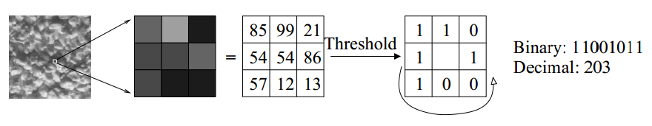
LBP
One the best performing texture descriptors
A label is assigned to every pixel
Use center pixel value to threshold the 3x3 neighborhood
Result in binary number
Histogram of the labels is used as a texture descriptor
The Basic LBP operator

Slide 5
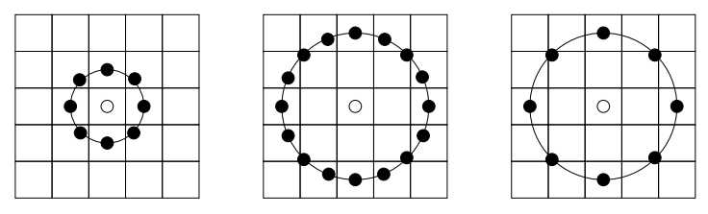
LBP (2)
LBP is extended to use different sizes of neighborhoods.
Local neighborhoods is defined as a set of sampling points.
points evenly spaced on a circle centered at the labeled pixel.
(P,R) , P = number of sampling points , R = radius
Bilinear interpolation is used if sampling point is not in the center of the pixel.
The circular (8,1), (16,2) and (8,2) neighborhoods. The pixel values are bilinearly
interpolated whenever the sampling point is not in the center of a pixel.

Slide 6
Uniform LBP
Uniform patterns to further improve LBP.
Uniform patterns has at most 2 bitwise transitions in binary pattern.
Histogram assigns separate bin for every uniform pattern.
Histogram assigns a single bin for all non-uniform pattern.
In FERET dataset, (8,1) neighborhoods : 90.6 percent of patterns are uniform.

Slide 7
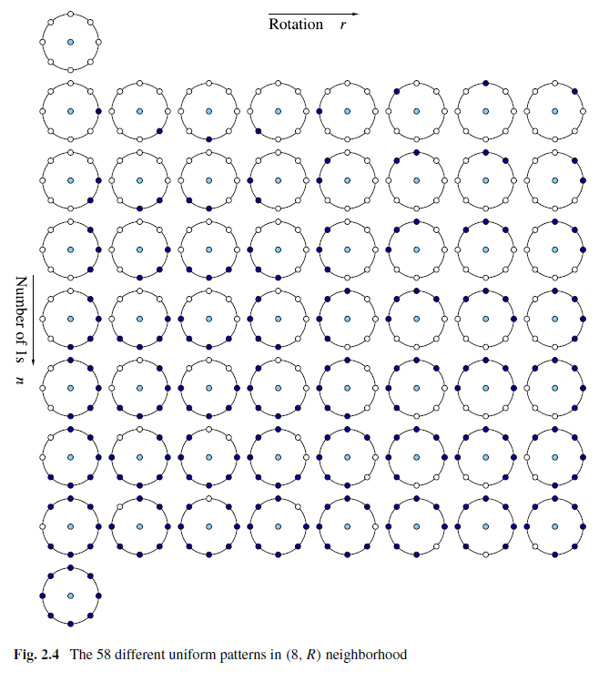
Uniform LBP (2)
Uniform patterns examples
  00000000 (0 transitions)
  01110000 (2 transitions)
  11001111 (2 transitions)
Non-uniform patterns examples
  11001001 (4 transitions)
  01010011 (5 transitions)
59 bins histogram →
Length of feature vector

Slide 8
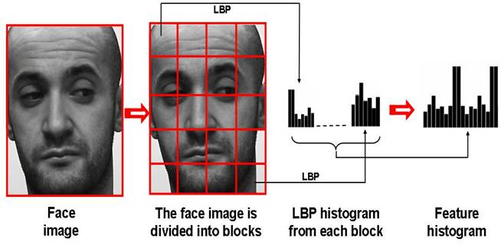
Face description using LBP
Step 1 : facial image is divided into local regions (blocks). {R0, R1, …, Rm-1} (pixel-level locality)
Step 2 : Extract LBP histogram for each region. (regional-level locality)
Step 3 : Concatenated all histograms into a spatially enhanced histogram with length of m x n (n is length of a single LBP histogram). (global-level locality)
Face description using LBP

Slide 9

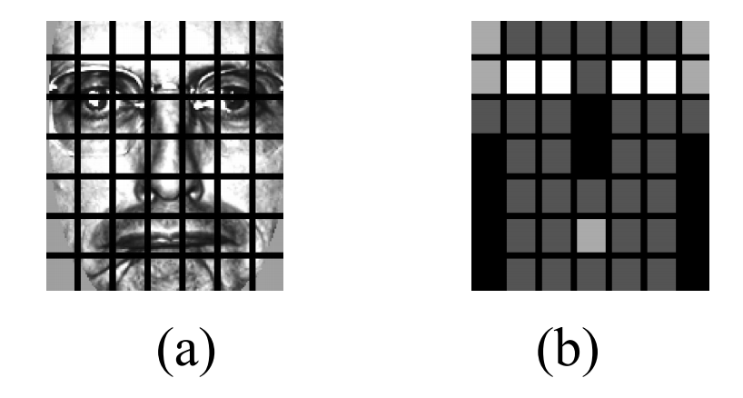
Face description using LBP
Specific facial features ( such as eyes) contain more important information
Be weighted based on the importance of information
Chi square distance is utilized
x and ξ= normalized enhanced histograms
i= histogram index
j= local region index
wj= weight of region j
(a) 7x7 windows (b) The weights set . Black squares indicate weight 0.0, dark gray 1.0, light gray 2.0 and white
4.0.

Slide 10
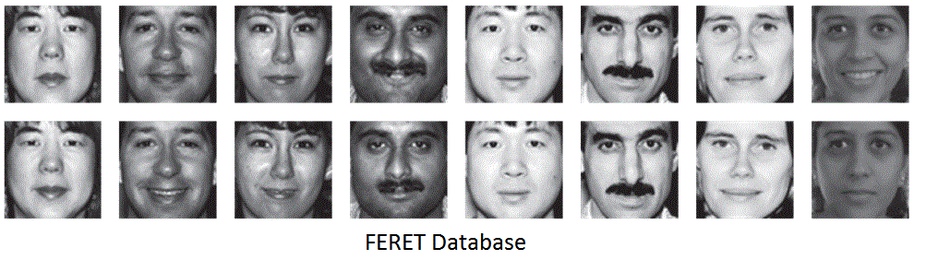
Dataset
fa set, used as a gallery set, contains frontal images of 1196 people.
fb set (1195 images). The subjects were asked for an alternative facial expression
fc set (194 images). The photos were taken under different lighting conditions.
dup I set (722 images). The photos were taken later in time.
dup II set (234 images). This is a subset of the dup I set containing those images that were taken at least a year after the corresponding gallery image

Slide 11
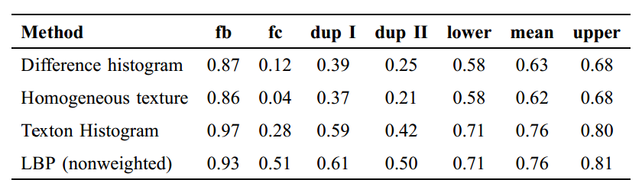
Results
Recognition Rate in Different Texture Descriptors For Local Facial Regions
LBP is tolerance to monotonic gray-scale changes
No gray-scale normalization is needed prior to apply
Highly discriminative
Computationally efficient

Slide 12
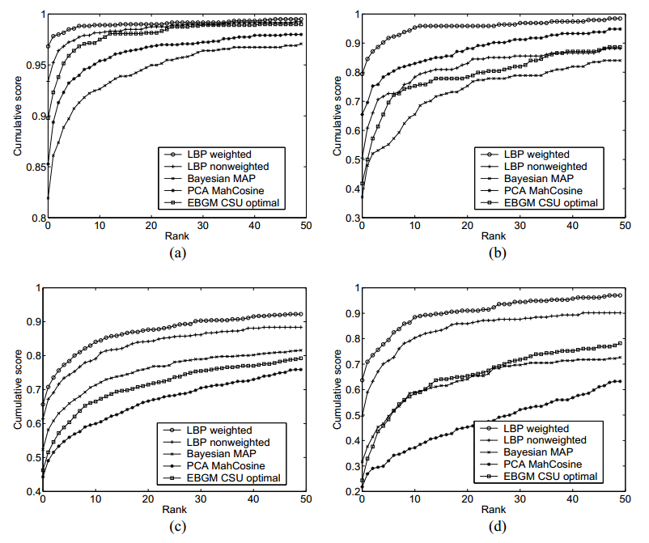
Results (2)
The cumulative scores of the LBP and control algorithms on the (a) fb , (b) fc , (c) dupI and (d) dup II probe sets.

Slide 13
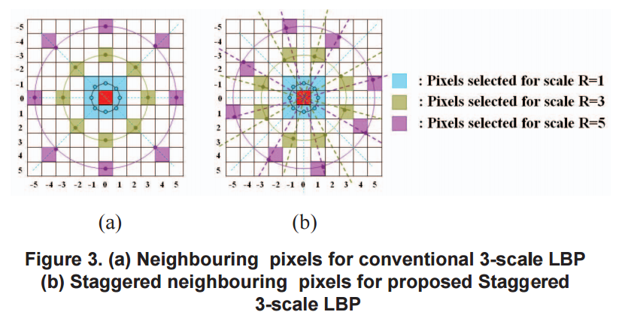
MLBP and Staggered MLBP
Multi-Scale LBP (MLBP)
  More than one scale of neighborhoods
  Three scale with alternative radiuses of 1,3, and 5 → more information
  3*256 = 768-bin histogram
Staggered MLBP
  3*8=24 directions instead of 8 direction in traditional MLBP→ more feature information and a higher performance is expected.

Slide 14
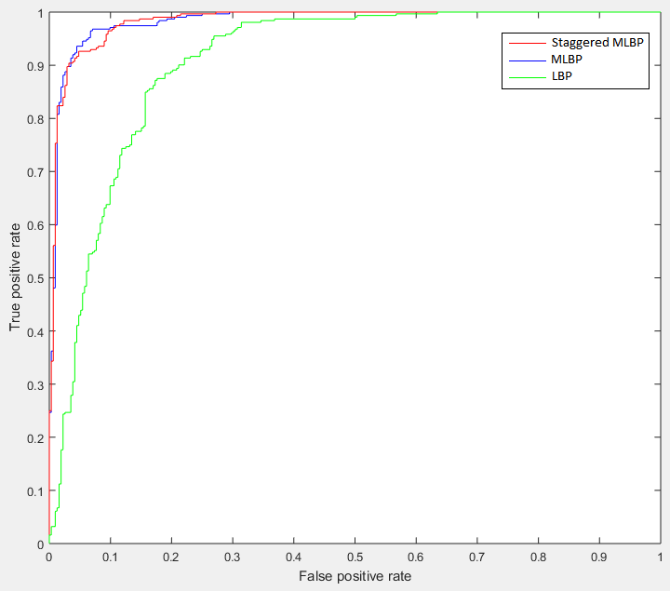
MLBP and Staggered MLBP (2)
Train 1300 positive and
1300 negative samples of
bicycle with LBP, MLBP and
staggered MLBP features
Test 300 positive and 300
negative images
ROC curves of LBP, MLBP and Staggered MLBP

Slide 15
Conclusion
Facial images can be seen as micro-patterns(spots, edges, lines, etc.).
This texture-based facial descriptor is based on dividing image into small regions.
Computing a texture description of each region using LBP.
Combined these descriptors into a spatially enhanced histogram or feature vector.
Weighted Regions, better performance
Pose invariant, illumination invariant, age invariant

Slide 16
References
Ahonen, T., Hadid, A., Pietikainen, M.: Face Description with Local Binary Patterns: Application to Face Recognition. Pattern Analysis and Machine Intelligence, Vol.28, no.12 (2006) 2037-2041
Cao, Y., Pranata, S., Yasugi, M., Zhiheng, N., Nishimura, H.: Staggered Multi-scale LBP for Pedestrian Detection. In: 19th IEEE International Conference on Image Processing (ICIP 2012), 449-452 (2013)
Http://www.scholarpedia.org/article/Local_Binary_Patterns

